Slide 1

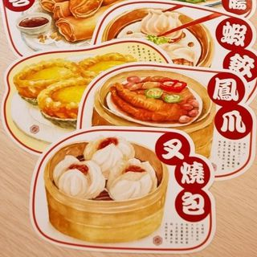
Food Delivery
Group Name : Big sun
Group members:
张贺（Alan）、肖林剑（Carter）、
高子喃（Hope）、张雨欣（Crystal）

Slide 2
01
Demand analysis
目录
02
Function introduced
Contents
03
The system interface

Slide 3
01
Demand analysis

Slide 4


With our project, you can order delivery or
take out online from your favorite fast food
restaurants like McDonalds or Subway.
Having fries, chicken nuggets, and more delivered right to your door just feels right
Introduction
It’s free to order, so save time tackling your to-do list at home, at work, or on the go.
Advantages

Slide 5
02
Function introduced

Slide 6
Old user login
New user and merchant
Search the menu
Name、Phone number、Address
Login
Registration
Order
Information

Slide 7
03
The system interface

Slide 8
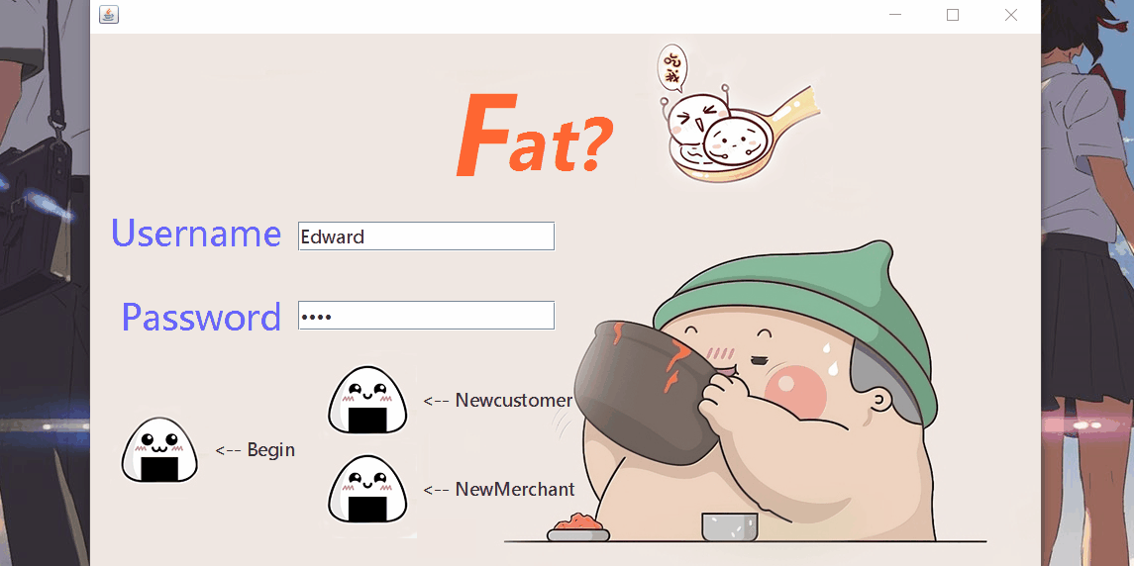
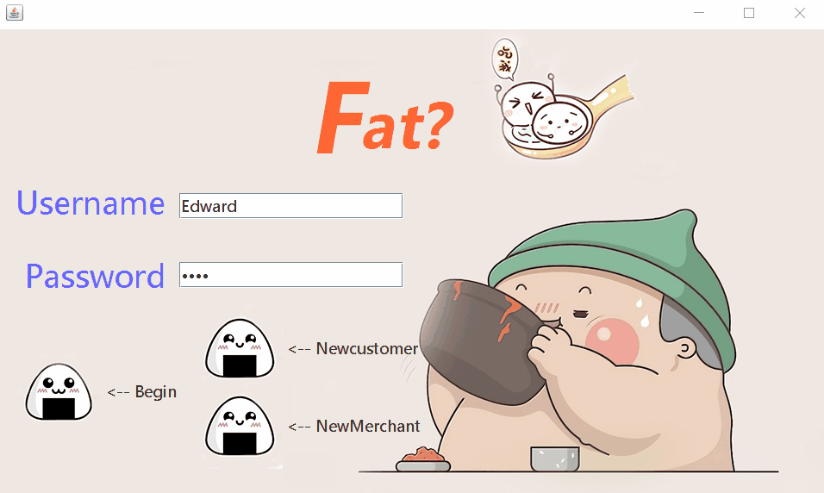
Unregistered user login
New user registration

Slide 9
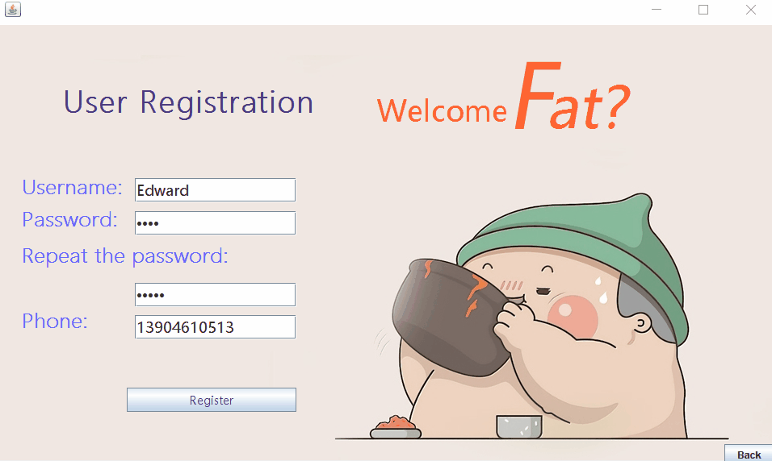
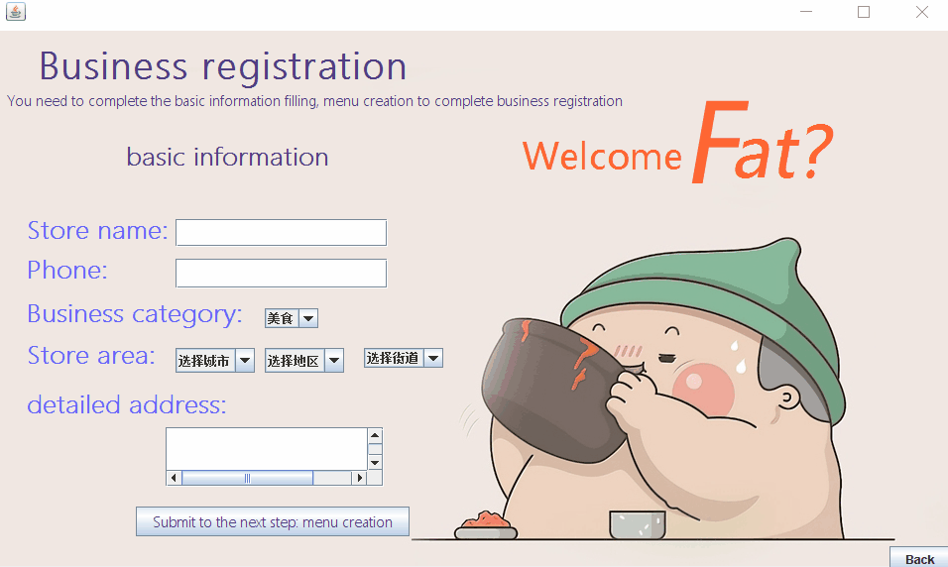
The repeat password should
be the same
New merchant registration

Slide 10
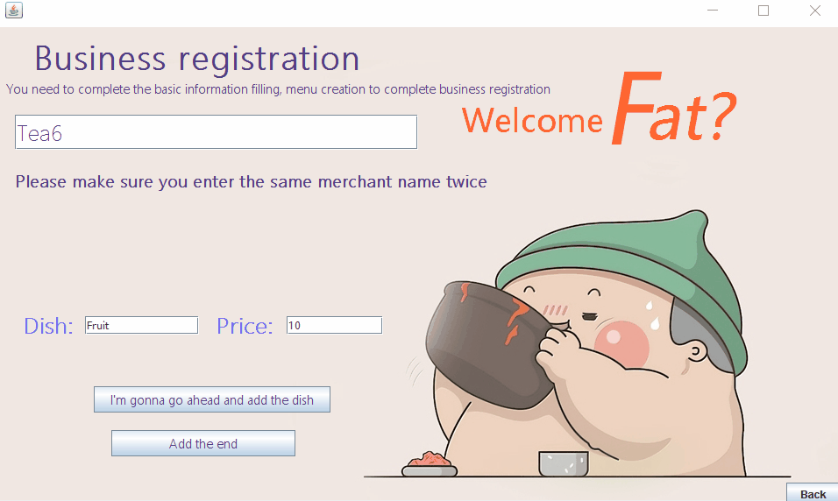
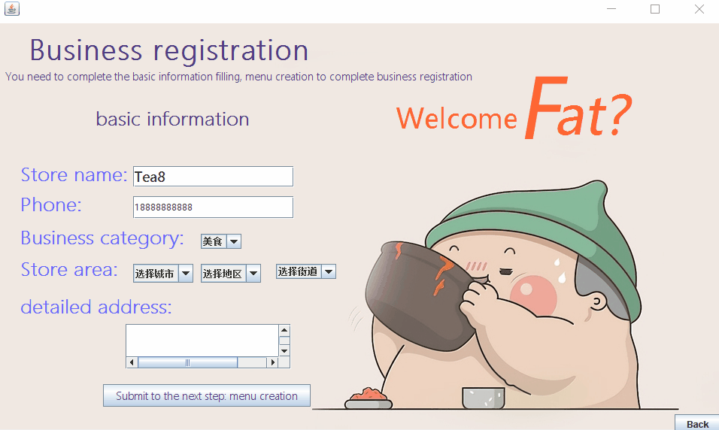
Changing menu needs to input
the correct merchant name
Make a menu

Slide 11

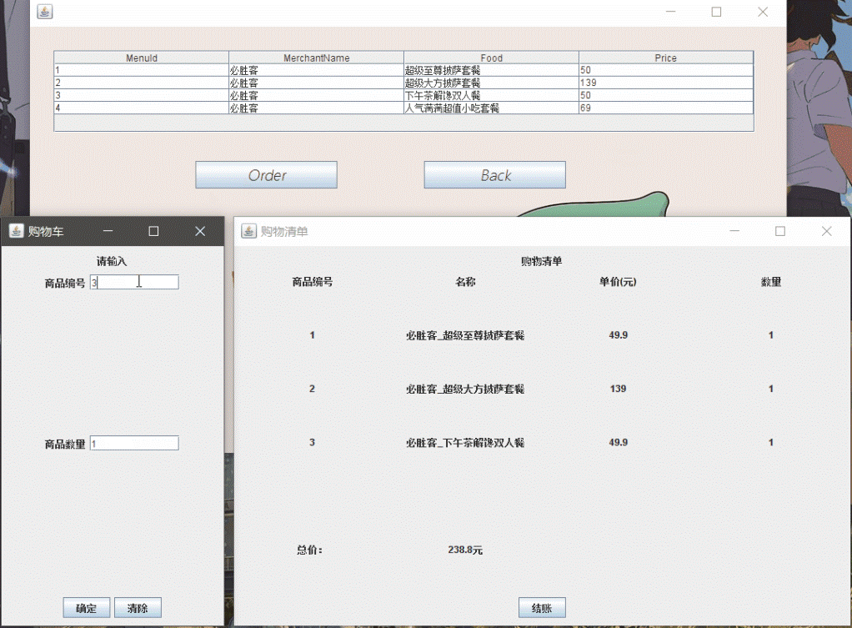
User login
Order food

Slide 12
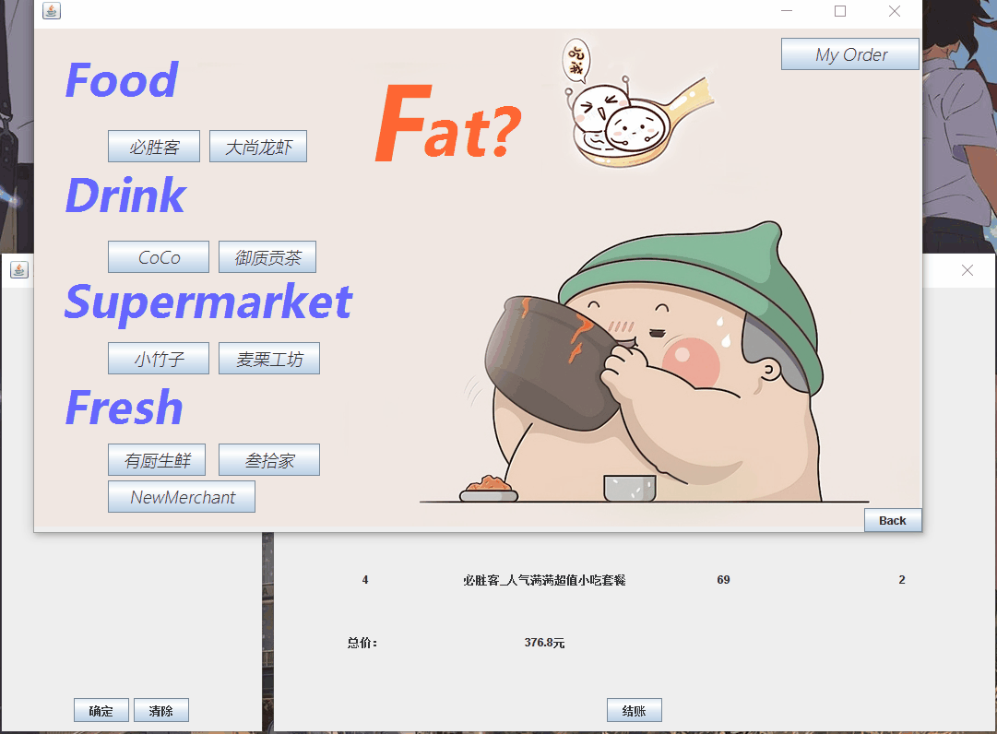
Order inquiry

Slide 13

Thanks for watching

